Slide 1
Lecture 12 Graphs
Exercises ANS
Department of Computer Science
Hofstra University
Acknowledgement: Lecture slides based on UofW Course on Data Structures

Slide 2
Q1. Adjacency matrix and adjacency list
Write out the adjacency matrix and adjacency list for the directed graph.
C
B
F
G
D
A
E

Slide 3

Q1. Adjacency matrix and adjacency list ANS
Write out the adjacency matrix and adjacency list for the directed graph.
 | A | B | C | D | E | F | G
A | 0 | 1 | 0 | 1 | 0 | 0 | 0
B | 0 | 0 | 1 | 0 | 0 | 0 | 0
C | 0 | 0 | 0 | 0 | 0 | 1 | 0
D | 0 | 1 | 0 | 0 | 1 | 1 | 0
E | 0 | 0 | 0 | 0 | 0 | 1 | 0
F | 0 | 0 | 0 | 0 | 0 | 0 | 0
G | 0 | 0 | 0 | 0 | 0 | 1 | 0
B, D
C
C
B
F
G
F
D
B, F, E
A
E
F
F

Slide 4
Q2. Adjacency matrix and adjacency list
Write out the adjacency matrix and adjacency list for the undirected graph.
C
B
F
G
D
A
E

Slide 5
Q2. Adjacency matrix and adjacency list ANS
Write out the adjacency matrix and adjacency list for the directed graph.
 | A | B | C | D | E | F | G
A | 0 | 1 | 0 | 1 | 0 | 0 | 0
B | 1 | 0 | 1 | 1 | 0 | 0 | 0
C | 0 | 1 | 0 | 0 | 0 | 1 | 0
D | 1 | 1 | 0 | 0 | 1 | 1 | 0
E | 0 | 0 | 0 | 1 | 0 | 1 | 0
F | 0 | 0 | 1 | 1 | 1 | 0 | 1
G | 0 | 0 | 0 | 0 | 0 | 1 | 0
C
B, D
A, C, D
B
F
G
B, F
D
A, B, E, F
A
E
D, F
C, D, E, G
F

Slide 6
Q3: Pre-Order & Post-Order Traversals
C
DFS Pre-Order:
DFS Post-Order:
B
F
G
D
A
E
Stack:
We use a stack-based implementation instead of recursive function calls
6
Notes:
Dark blue: Most recently marked
Light blue: Node has been marked, in the middle of visiting its children
Green: Node has been marked and we’re finished visiting (have seen all children)

Slide 7
C
DFS Pre-Order:
A
DFS Post-Order:
B
F
G
D
A
E
Stack: A
7
Notes:
Dark blue: Most recently marked
Light blue: Node has been marked, in the middle of visiting its children
Green: Node has been marked and we’re finished visiting (have seen all children)

Slide 8
C
DFS Pre-Order:
A, B
DFS Post-Order:
B
F
G
D
A
E
Stack: A, B
8

Slide 9
C
DFS Pre-Order:
A, B, C
DFS Post-Order:
B
F
G
D
A
E
Stack: A, B, C
9

Slide 10
C
DFS Pre-Order:
A, B, C, F
DFS Post-Order:
B
F
G
D
A
E
Stack: A, B, C, F
10

Slide 11
C
DFS Pre-Order:
A, B, C, F
DFS Post-Order:
F
B
F
G
D
A
E
Stack: A, B, C
11

Slide 12
C
DFS Pre-Order:
A, B, C, F
DFS Post-Order:
F, C
B
F
G
D
A
E
Stack: A, B
12

Slide 13
C
DFS Pre-Order:
A, B, C, F
DFS Post-Order:
F, C, B
B
F
G
D
A
E
Stack: A
13

Slide 14
C
DFS Pre-Order:
A, B, C, F, D
DFS Post-Order:
F, C, B
B
F
G
D
A
E
Stack: A, D
14

Slide 15
C
DFS Pre-Order:
A, B, C, F, D, E
DFS Post-Order:
F, C, B,
B
F
G
D
A
E
Stack: A, D, E
15

Slide 16
C
DFS Pre-Order:
A, B, C, F, D, E
DFS Post-Order:
F, C, B, E
B
F
G
D
A
E
Stack: A, D
16

Slide 17
C
DFS Pre-Order:
A, B, C, F, D, E
DFS Post-Order:
F, C, B, E, D
B
F
G
D
A
E
Stack: A,
17

Slide 18
C
DFS Pre-Order:
A, B, C, F, D, E
DFS Post-Order:
F, C, B, E, D, A
B
F
G
D
A
E
Stack:

Slide 19
DFS Pre-Order:
A, B, C, F, D, E, G
DFS Post-Order:
F, C, B, E, D, A, G
Toplogical Sort (reverse of DFS Post-Order):
G, A, D, E, B, C, F
C
B
F
G
D
A
E
* if we allow DFS to restart on unmarked nodes, G would be added to the stack (and forming the last element in both the preorder and postorder traversals)
Stack:
19

Slide 20
Q4. BFS
C
BFS:
B
F
G
D
A
E
Queue: A
20
Notes:
Dark blue: Most recently marked
Light blue: Node has been marked, in the middle of visiting its children
Green: Node has been marked and we’re finished visiting (have seen all children)

Slide 21
C
BFS:
A
B
F
G
D
A
E
Queue: B D
21
Notes:
Dark blue: Most recently marked
Light blue: Node has been marked, in the middle of visiting its children
Green: Node has been marked and we’re finished visiting (have seen all children)

Slide 22
C
BFS:
A B
B
F
G
D
A
E
Queue: D C
22
Notes:
Dark blue: Most recently marked
Light blue: Node has been marked, in the middle of visiting its children
Green: Node has been marked and we’re finished visiting (have seen all children)

Slide 23
C
BFS:
A B D
B
F
G
D
A
E
Queue: C E F
23
Notes:
Dark blue: Most recently marked
Light blue: Node has been marked, in the middle of visiting its children
Green: Node has been marked and we’re finished visiting (have seen all children)

Slide 24
C
BFS:
A B D C
B
F
G
D
A
E
Queue: E F
24
Notes:
Dark blue: Most recently marked
Light blue: Node has been marked, in the middle of visiting its children
Green: Node has been marked and we’re finished visiting (have seen all children)

Slide 25
C
BFS:
A B D C E
B
F
G
D
A
E
Queue: F
Notes:
Dark blue: Most recently marked
Light blue: Node has been marked, in the middle of visiting its children
Green: Node has been marked and we’re finished visiting (have seen all children)

Slide 26
C
BFS:
A B D C E F
B
F
G
D
A
E
Queue:
26
Notes:
Dark blue: Most recently marked
Light blue: Node has been marked, in the middle of visiting its children
Green: Node has been marked and we’re finished visiting (have seen all children)

Slide 27
C
BFS:
A B D C E F
B
F
G
D
A
E
Queue: G
27
Notes:
Dark blue: Most recently marked
Light blue: Node has been marked, in the middle of visiting its children
Green: Node has been marked and we’re finished visiting (have seen all children)

Slide 28
C
BFS:
A B D C E F G
B
F
G
D
A
E
Queue:
28
Notes:
Dark blue: Most recently marked
Light blue: Node has been marked, in the middle of visiting its children
Green: Node has been marked and we’re finished visiting (have seen all children)

Slide 29
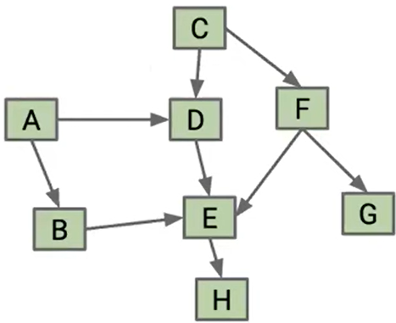
Q5. Graph Traversals
Starting from node A:
Pre-order traversal:
Post-order traversal:
Topological Sort:
BFS:
Starting from node C:
Pre-order traversal:
Post-order traversal:
Topological Sort:
BFS:
29
Notes:
Pre-order traversal is (A, B, E, H, D, C, F, G)
Post-order traversal is (H, E, B, D, A, G, F, C)
Topological Sort is (C, F, G, A, D, B, E, H)
Pre-order traversal is (C, D, E, H, F, G, A, B)
Post-order traversal is (H, E, D, G, F, C, B, A)
Topological Sort is (A, B, C, F, G, D, E, H)

Slide 30
Q5. Graph Traversals ANS
Starting from node A:
Pre-order traversal: (A, B, E, H, D, C, F, G)
Post-order traversal: (H, E, B, D, A, G, F, C)
Topological Sort: (C, F, G, A, D, B, E, H)
BFS: (A, B, D, E, H, C, F, G)
Starting from node C, ‘
Pre-order traversal: (A, B, E, H, D, C, F, G)
Post-order traversal: (H, E, B, D, A, G, F, C)
Topological Sort: (C, F, G, A, D, B, E, H)
BFS: (C, D, F, E, G, H, A, B)
30
Notes:
Pre-order traversal is (A, B, E, H, D, C, F, G)
Post-order traversal is (H, E, B, D, A, G, F, C)
Topological Sort is (C, F, G, A, D, B, E, H)
C, D, E, H, F, G, A, B

Slide 31
Dijkstra’s Algo: find shortest paths starting from source vertex S for the undirected graph
ANS
ANS
A
A
2
Vertex | SD | PN
S | 0
A
B
2
Vertex | SD | PN
S | 0
A
B
S
S
1
3
4
4
B
B
ANS
ANS
A
A
Vertex | SD | PN
S | 0
A
B
2
Vertex | SD | PN
S | 0
A
B
2
S
S
1
1
4
4
B
B
31
Notes:
SD: Shortest Distance. PN: Previous Node

Slide 32
Dijkstra’s Algo: find shortest paths starting from source vertex S for the undirected graph
ANS
ANS
A
A
2
Vertex | SD | PN
S | 0
A | 2 | S
B | 4 3 | S A
2
Vertex | SD | PN
S | 0
A | 2 | S
B | 4 | S
S
S
1
3
4
4
B
B
ANS
ANS
A
A
Vertex | SD | PN
S | 0
A | 5 | B
B | 4 | S
2
Vertex | SD | PN
S | 0
A | 2 | S
B | 4 | S
2
S
S
1
1
4
4
B
B
32
Notes:
SD: Shortest Distance. PN: Previous Node

Slide 33
Dijkstra’s Algo: find shortest paths starting from source vertex S for the undirected graph
3
B
D
3
1
A
1
2
1
C
E
4
33
Notes:
David Kauchak
cs161
Summer 2009
Graphs: MSTs and Shortest Paths https://cs.pomona.edu/~dkauchak/classes/algorithms/

Slide 34
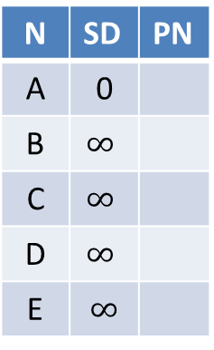
Initialize
∞
∞
3
N | SD | PN
A | 0
B | $$∞$$
C | $$∞$$
D | $$∞$$
E | $$∞$$
B
D
3
0
1
A
1
2
∞
1
C
E
∞
4
34

Slide 35
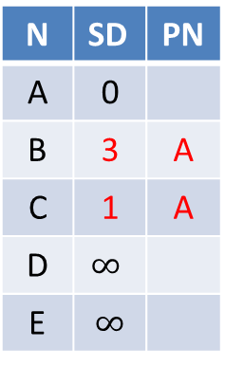
Visit vertex A
3
∞
3
N | SD | PN
A | 0
B | 3 | A
C | 1 | A
D | $$∞$$
E | $$∞$$
B
D
3
0
1
A
1
2
1
1
C
E
∞
4
35

Slide 36
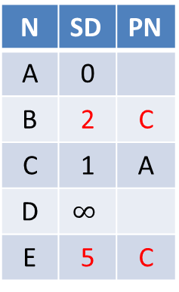
Visit vertex C
2
∞
3
N | SD | PN
A | 0
B | 2 | C
C | 1 | A
D | $$∞$$
E | 5 | C
B
D
3
0
1
A
1
2
1
1
C
E
5
4
36

Slide 37
Visit vertex B
2
5
3
N | SD | PN
A | 0
B | 2 | C
C | 1 | A
D | 5 | B
E | 3 | B
B
D
3
0
1
A
1
2
1
1
C
E
3
4
37

Slide 38
Visit vertex E
2
5
3
B
D
N | SD | PN
A | 0
B | 2 | C
C | 1 | A
D | 5 | B
E | 3 | B
3
0
1
A
1
2
1
1
C
E
3
4
Nothing changes
38

Slide 39
Visit vertex D
2
5
3
N | SD | PN
A | 0
B | 2 | C
C | 1 | A
D | 5 | B
E | 3 | B
B
D
3
0
1
A
1
2
1
1
C
E
3
4
Nothing changes
39

Slide 40
Dijkstra’s Algo: ANS
At exam time, you will be given a graph with a start node (A), and required to fill in this table, crossing out old items as you find a shortcut path
3
B
D
3
Vertex | distTo | edgeTo
A | 0
B | 3 2 | A C
C | 1 | A
D | 5 | B
E | 5 3 | C B
1
A
1
2
1
C
E
4
40

Slide 41
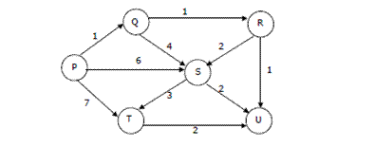
Dijkstra’s Algo: find shortest paths starting from source vertex S for the undirected graph

Slide 42
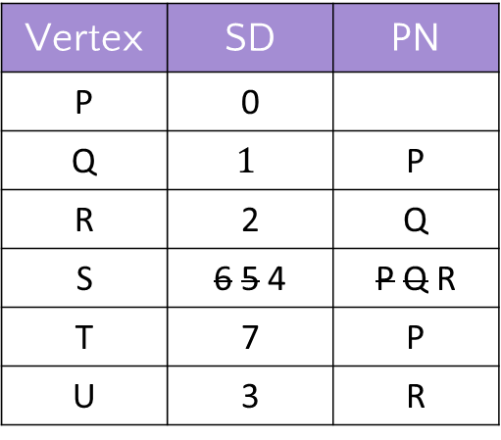
Dijkstra’s Algo: find shortest paths starting from source vertex P for the directed graph
Visit order: P, Q, R, U, S, T
Vertex | SD | PN
P | 0
Q | $$1$$ | P
R | 2 | Q
S | 6 5 4 | P Q R
T | 7 | P
U | 3 | R

